Slide 1
SCI Recovery CS 6460: Ed. Tech
MILESTONE #2
By dhruv Kapoor, Tolga Saygi, clark xu

Slide 2
Motivation
Spinal cord injuries (SCIs) impact 250,000 – 500,000 people around the world (World Health Organization, 2013)
Outcomes include paralysis, loss of sensation, increased chance of developing pressure ulcers, bladder dysfunction, neurogenic bowel, muscle atrophy, autonomic dysreflexia, and impaired sexual function (Sezer, Akkuş, & Uğurlu, 2015)
The best tools for prognosis have remained standard of care diagnostics such as MRIs and bedside evaluation, or traditional clinical analysis (Burns et al., 2012)
We wish to add to this clinical arsenal using both an educational platform as well as modern machine learning techniques
Notes:
So, what are scis and why are we interested

Slide 3
Prior Work
A mobile application for self-managing SCI was developed and received well by 20 injured individuals and 56 caregivers (Mortenson et al., 2019)
When surveyed, subjects with SCIs found that an internet-based platform that was designed for people with their own level of injury in mind would be best for developing informational resources (Munce et. al., 2014)
Age has been found to be a crucial factor when predicting recovery (Seel et al., 2001; Wilson et al., 2012; Wilson et al., 2014)
We found a lot of literature around SCI recovery using correlation or classical approaches such as linear regression, but none that used a comprehensive set of modern machine learning tools
Notes:
The prior work we paid special attention to include how information is preferred to be consumed and from where prognoses are derived from in practice

Slide 4
Purpose
To create a mobile application based on information surrounding spinal cord injuries (SCIs)
To provide educational content on the difficulty of predicting recovery following such injuries
To engage in novel research around predicting SCI recovery with respect to the ASIA impairment scale, which has widespread medical usage
To plug in predictive machine learning into the application so inference can be run for provided patient details
Notes:
5 stages, abcde, a is most severe with no motorsensory function
Will be demonstrated

Slide 5
Recap From Milestone #1
NSCISC dataset was retrieved, which had ~30,000 patient samples from the United States
Extensive programmatic mapping was done by referencing a data dictionary so that data values could be translated into understandable names
Exploratory data analysis was performed to identify problematic data features in terms of missing values and abnormally prevalent values
Mobile application was scaffolded with different screens and text
Ubuntu server, which will host the ML model and inference API, was created with a basic Falcon endpoint that was accessible through a REST call

Slide 6
Progress: Model Training
There was extensive work done to tune different models in order to achieve the highest accuracy on predicting ASIA score
The train:test split was roughly 90:10 and test data started for injuries since 2006
Training results:
Model | Train Accuracy (%) | Test Accuracy (%)
Elastic Net | 82.0 | 72.0
Logistic Regression | 82.0 | 71.8
Random Forest | 94.2 | 69.8
KNN | 83.5 | 69.6
Gradient Boost | 86.2 | 67.2
Decision Tree | 94.2 | 60.9
AdaBoost | 72.4 | 49.8
Gaussian NB | 48.2 | 27.6
Notes:
After trailing different variations of hyperparamaters for each of these, our best model was elastic net with 72% on the test accuracy

Slide 7
Progress: Ubuntu Server
Python environment manifest was created for Windows and Ubuntu so cross-platform development can translate between team members and the server
Inference API was created on the server to take in prediction requests and output an ASIA classification
The inference code itself was written to pull any model we have trained with ease since the training features are consistent across them all
More on this…

Slide 8

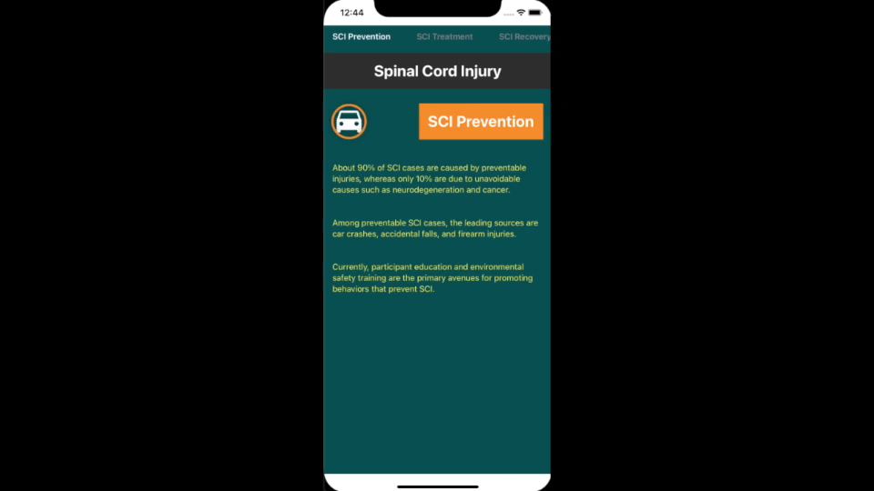
Progress: Mobile App
Notes:
Pages to tabs, more information, inference client

Slide 9
Next Steps
To research and implement variable importance to provide further education into how certain features can impact recovery predictions
To incorporate variable importance results on the mobile application
To continue iterating on the static educational content on the mobile application
To refine any mobile application design decisions in terms of how content is displayed

Slide 10
References
Burns, A., et al.(2012). Clinical diagnosis and prognosis following spinal cord injury. Handbook of Clinical Neurology 109. https://doi.org/10.1016/B978-0-444-52137-8.00003-6
Mortenson, W., Singh, G., MacGillivray, M., Sadeghi, M., Mills, P., Adams, J., & Sawatzky, B. (2019). Development of a Self-Management App for People with Spinal Cord Injury. Journal Of Medical Systems, 43(6). https://doi.org/10.1007/s10916-019-1273-x
Munce, S., Fehlings, M., Straus, S., Nugaeva, N., Jang, E., Webster, F., & Jaglal, S. (2014). Views of people with traumatic spinal cord injury about the components of self-management programs and program delivery: a Canadian pilot study. BMC Neurology, 14(1). https://doi.org/10.1186/s12883-014-0209-9
Seel, R., Huang, M., Cifu, D., Kolakowsky-Hayner, S., & McKinley, W. (2001). Age-Related Differences In Length Of Stays, Hospitalization Costs, And Outcomes For An Injury-Matched Sample Of Adults With Paraplegia. The Journal Of Spinal Cord Medicine, 24(4), 241-250. https://doi.org/10.1080/10790268.2001.11753581
Sezer, N., Akkuş, S., & Uğurlu, F.G. (2015). Chronic complications of spinal cord injury. World journal of orthopedics, 6(1), 24–33. http://dx.doi.org/10.5312/wjo.v6.i1.24
Wilson, J., Davis, A., Kulkarni, A., Kiss, A., Frankowski, R., Grossman, R., & Fehlings, M. (2014). Defining age-related differences in outcome after traumatic spinal cord injury: analysis of a combined, multicenter dataset. The Spine Journal, 14(7), 1192-1198. https://doi.org/10.1016/j.spinee.2013.08.005
Wilson, J., Grossman, R., Frankowski, R., Kiss, A., Davis, A., & Kulkarni, A. et al. (2012). A Clinical Prediction Model for Long-Term Functional Outcome after Traumatic Spinal Cord Injury Based on Acute Clinical and Imaging Factors. Journal Of Neurotrauma, 29(13), 2263-2271. https://doi.org/10.1089/neu.2012.2417
World Health Organization (2013). Spinal cord injury. https://www.who.int/news-room/fact-sheets/detail/spinal-cord-injury

